Slide 1
UNIT 5
Direct Broadcast Satellite Services

Slide 2
CONTENTS
Introduction
Orbital Spacings
Power Rating and Number of Transponders
Frequencies and Polarization
Transponder Capacity

Slide 3
Direct Broadcast Satellite (DBS) Services
Satellites provide broadcast transmissions in the fullest sense of the word, because antenna footprints can be made to cover large areas of the earth. The idea of using satellites to provide direct transmissions into the home has been around for many years, and the services provided are known generally as Direct Broadcast Satellite (DBS) services.
Broadcast services include ,
audio,
television,
Internet services.
Direct broadcast television ( digital TV)
Planned broadcasting directly to home TV receivers using satellite is know as direct broadcast satellite (DBS) services

Slide 4
Orbital Spacing
The minimum orbital spacing for satellite is 2⁰ and the maximum orbital spacing is 9⁰
The for orbital spacing for DBS or the high-power satellite is 9⁰
The DBS orbital positions along with the transponder allocations for the United States are spaced by 9 degrees.
It should be noted that although the DBS services are spaced by 9°, clusters of satellites occupy the nominal orbital positions.

Slide 5
Power Rating # The power rating of satellite is decided by EIRP (effective isotropic radiated power) # The DBS have a higher EIRP (Effective Isotropic Radiated Power, ) than for the other categories - in the range of 51 to 60 dBW. # The EIRP value established for DBS was 57 dBW by Regional Administrative Radio Council (RARC) Transponders # Typically a satellite may carry 32 transponders. # Each will operate at low power rating of 120W
Power Rating and Number of Transponders

Slide 6
Frequencies and Polarization
For the higher power satellites
Uplink frequency range : 17.3 to 17.8 GHz
Downlink range : 12.2 to 12.7 GHz.
Primary use : DBS Services
DBS Service takes place in Ku band and the freq will vary from region to region.
For the medium powersatellites
Uplink frequency range : 14 to 14.5 GHz
Downlink range : 11.7 to 12.2 GHz.
Primary use :Point to Point Communication

Slide 7
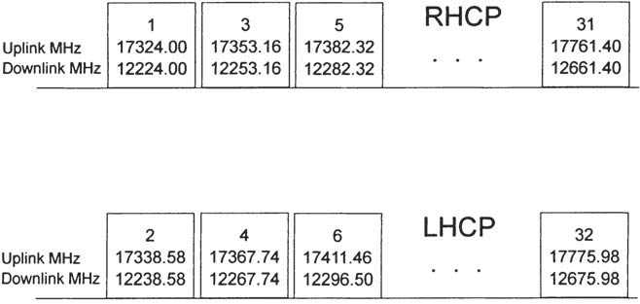
Fig :The DBS frequency plan for Region 2
The available bandwidth is seen to be 500 MHz.
A total number of 32 transponder channels, each bandwidth 24 MHz.
Sometimes, the bandwidth is 27 MHz including 3 MHz guard band allowance
The transponder uses of both RightHand Circular Polarization (RHCP) And Left-Hand Circular Polarization (LHCP) in order to permit frequency reuse, and guard bands are inserted between channels of a given polarization.

Slide 8
Transponder Capacity
The 24 MHz bandwidth of a transponder is capable of carrying one analog television channel.
DBS - direct-to-home (DTH) television requires many more channels
Digitizing the audio and video components of a television program allows signal compression to be applied, which greatly reduces the bandwidth required.

Slide 9



the symbol rate that can be transmitted in a given bandwidth is
Thus, with a bandwidth of 24 MHz and allowing for a rolloff factor of 0.2, the symbol rate is
Satellite digital television uses QPSK. Thus, using M = 4 gives m =2, m= log₂M
and the bit rate is given by,
This is the bit rate that can be carried in the 24-MHz channel using QPSK.

